Slide 1
Introduction to VHF and UHF
Applications to the Amateur Radio uses of this spectrum

Slide 2
What you will learn
What is considered to be VHF and UHF and why?
How does it differ from HF bands in uses and characteristics?
What parts of the spectrum can amateurs use?
What types of modulation are used? Why dominated by FM?
Can I use AM or SSB on VHF and UHF?
What antennas do I need? What about polarization?
How are digital modes used on VHF and UHF?
What is the range of acceptable communications with VHF and UHF signals?
How does a repeater work?
How does ARES use this technology?

Slide 3
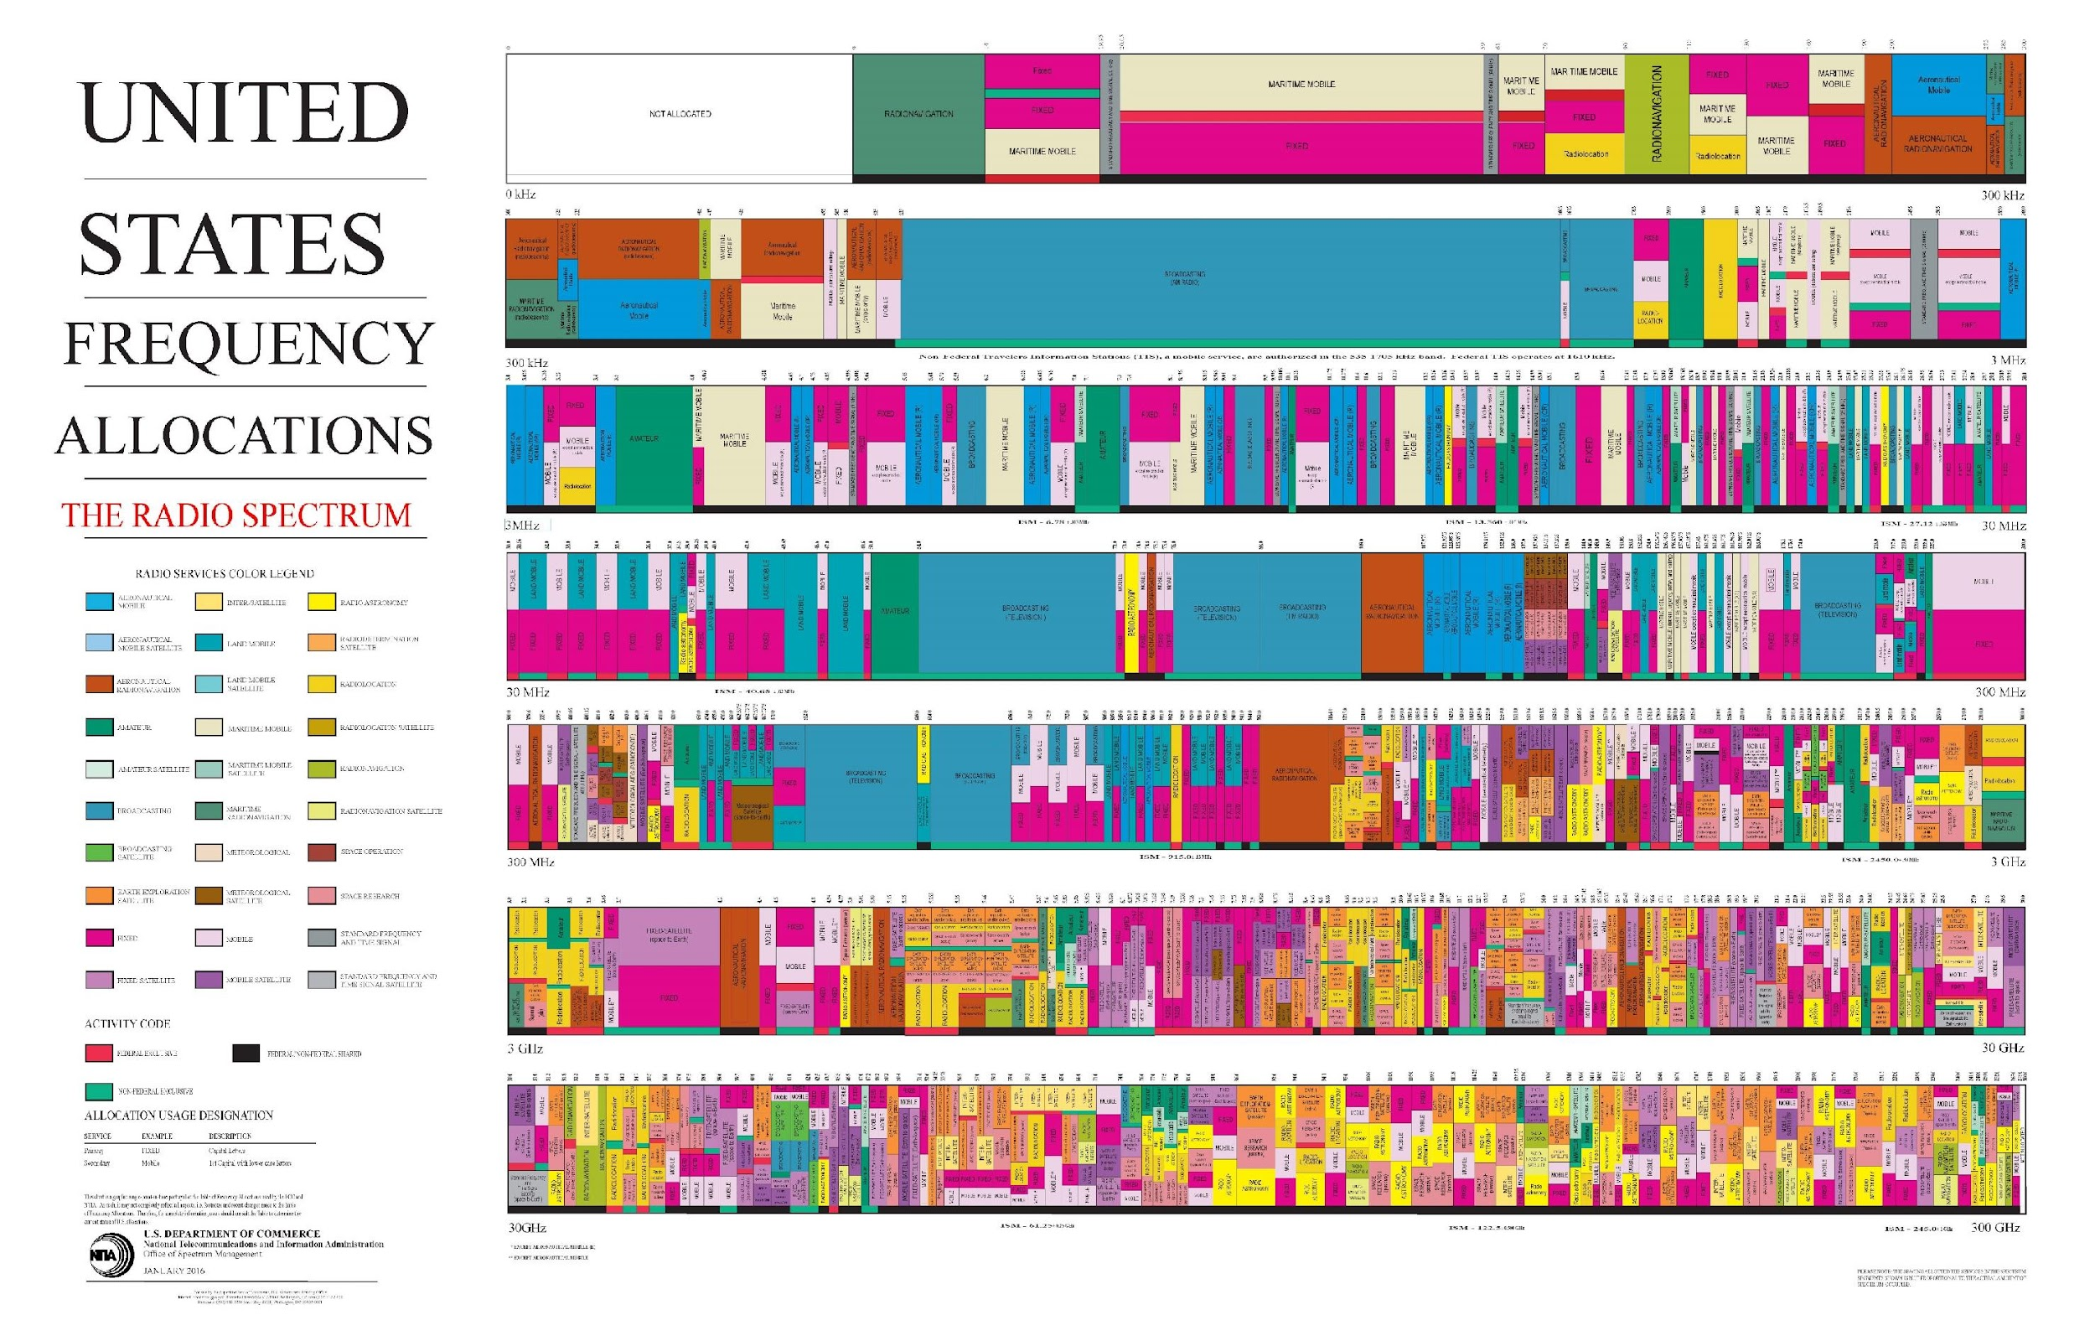
LF
HF
HF
VHF
UHF
Microwave
SHF
EHF

Slide 4
Amateur Radio VHF and UHF Spectrum
VHF
6m
2m
1.25m
30MHz
50MHz –
54MHz
144MHz –
148MHz
219MHz –
220MHz*
300MHz
222MHz –
225MHz
70
cm
33 cm
23 cm
13 cm
UHF
300MHz
420MHz –
450MHz
902MHz –
928MHz
1240MHz –
1300MHz
2390MHz –
2417MHz
3GHz

Slide 5
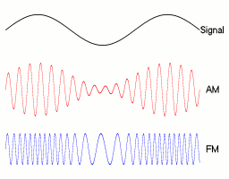
Modulation Used
FM (frequency modulation) is the most common.
AM is used on VHF for Aircraft communications
CW can be used at any of the VHF or UHF frequencies, but is most often used by the Microwave amateurs
SSB is used for VHF and UHF Contesting and is almost always horizontal polarization
Digital modes are common. FT8, FLDIGI, and VARA-FM for Winlink, are most common. FM-packet still used but fading.
Digital voice mode is used for D-Star, Fusion, AllStar, DMR, and new modes like M17

Slide 6
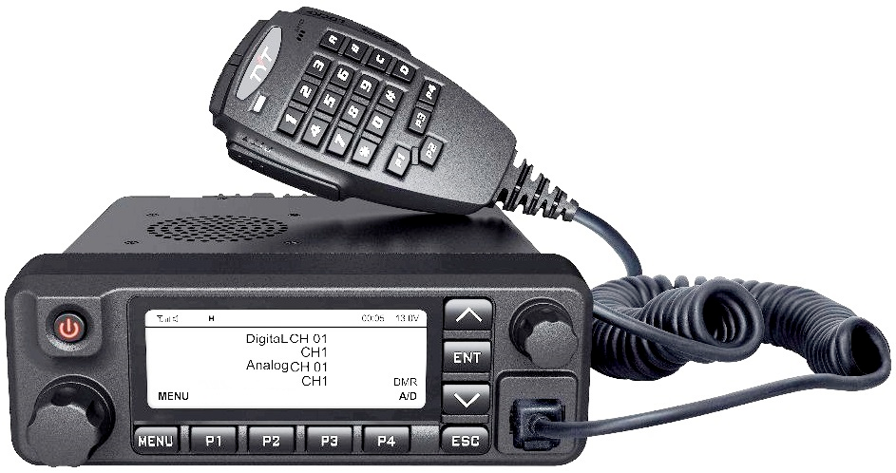
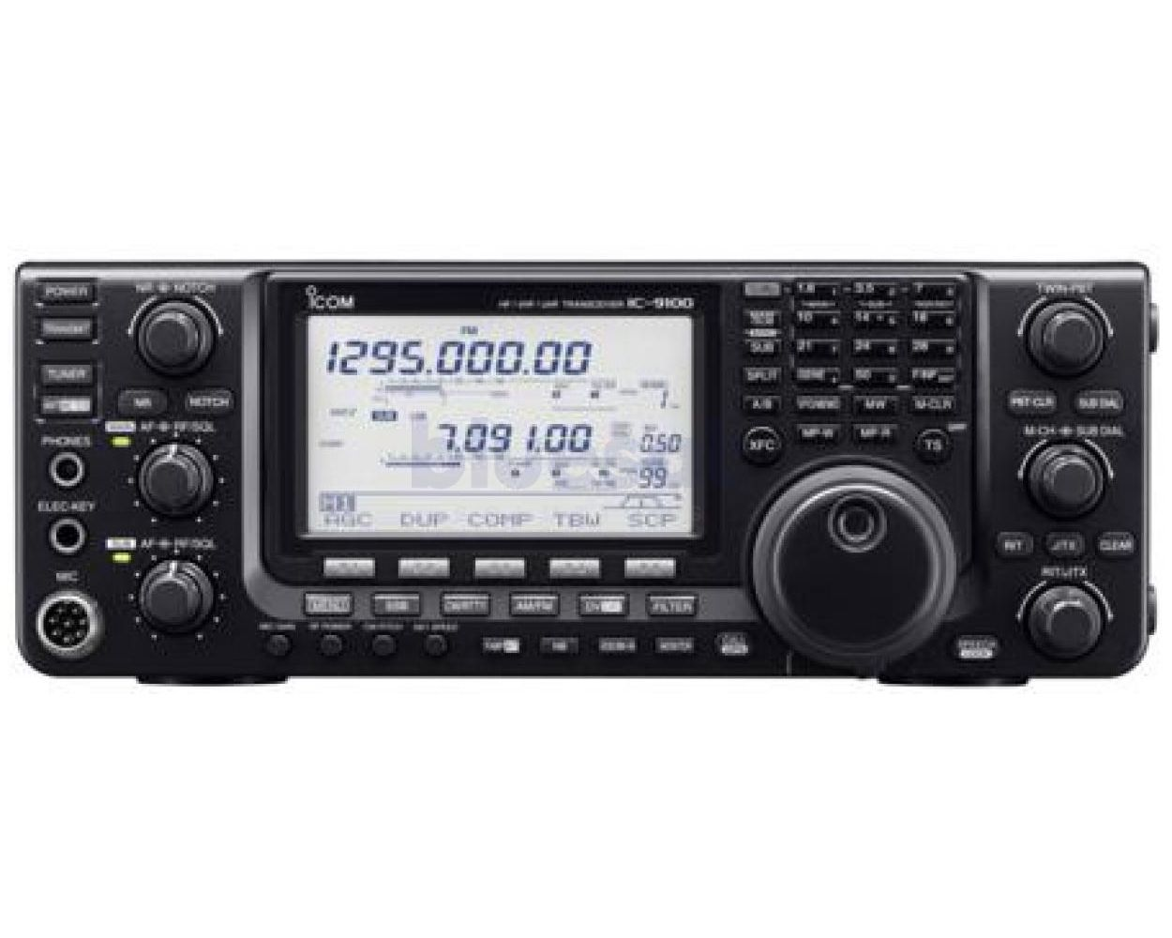
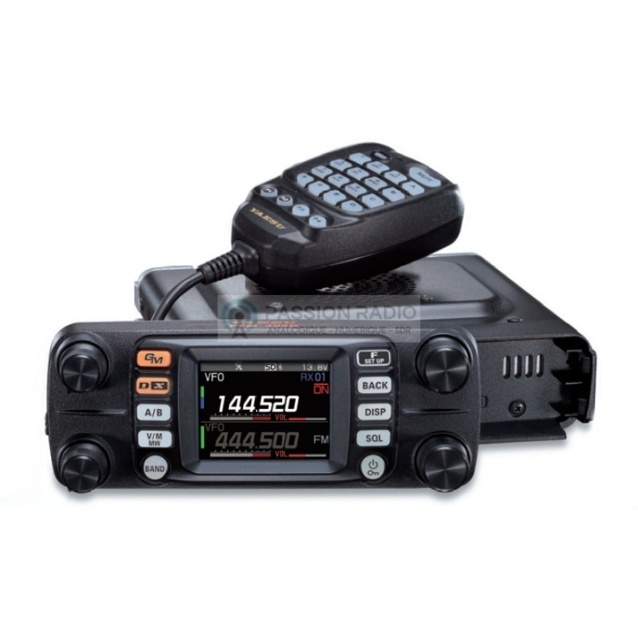
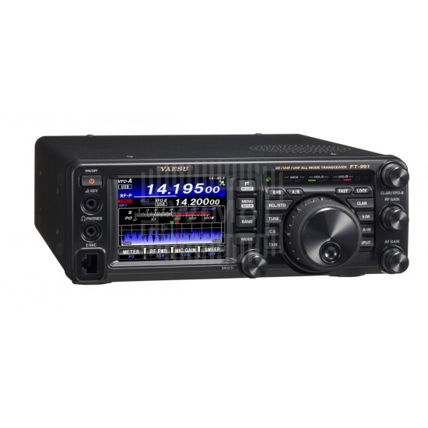
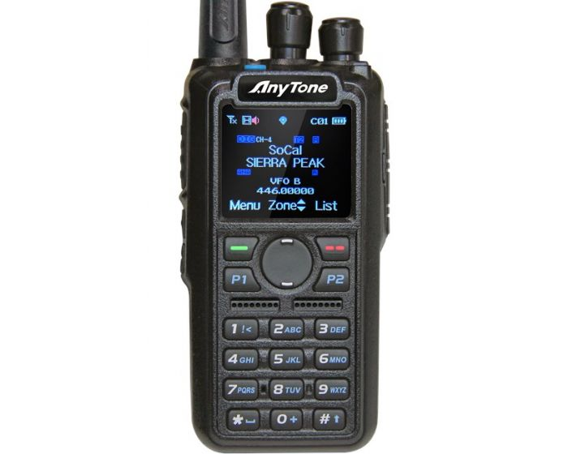
What Modes I can use with what radio?
VHF/UHF/DMR
Any of the discussed modes can be used, but require a radio equipped for these modes.
Check your equipment for what is supported.
AM/FM/SSB/CW/D-Star
VHF/UHF/FM & DMR
AM/FM/SSB/CW/Fusion
VHF/UHF/Fusion

Slide 7
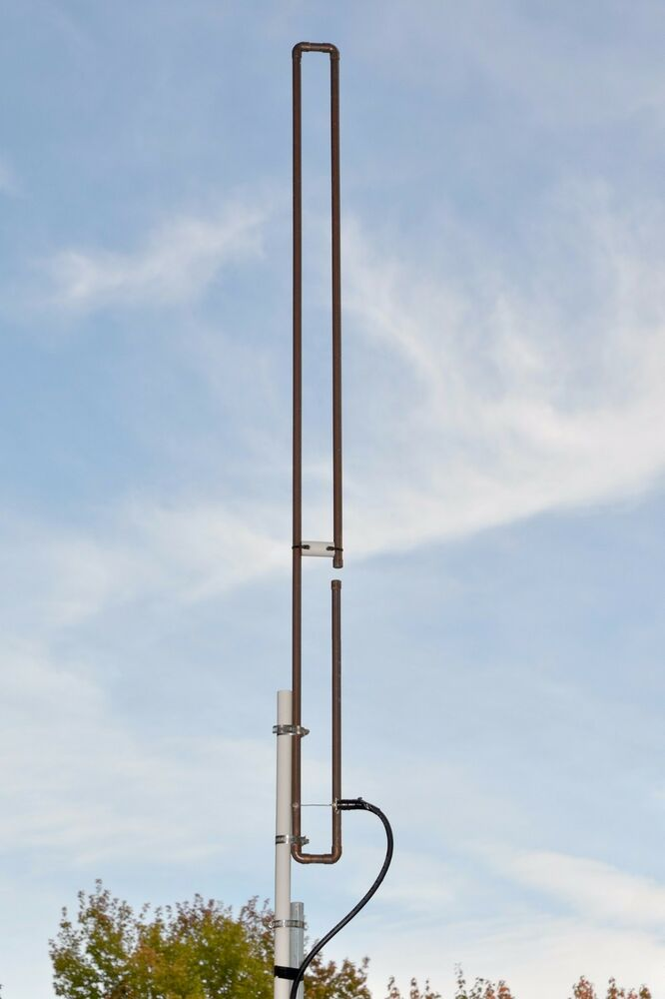
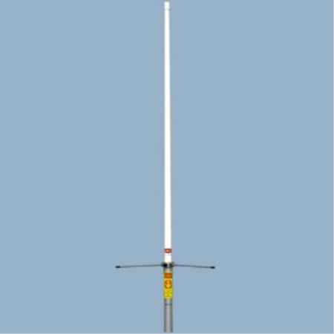
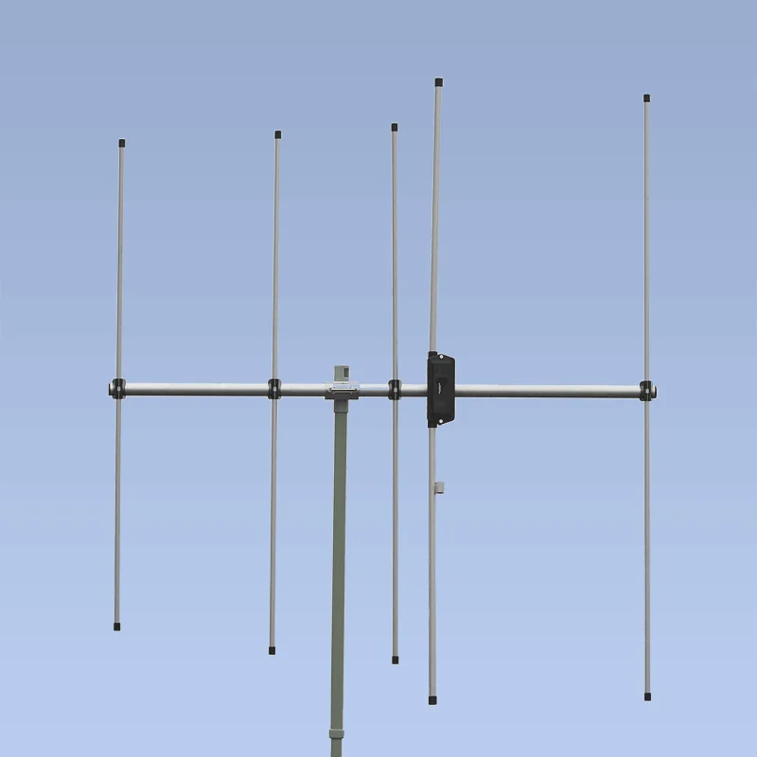
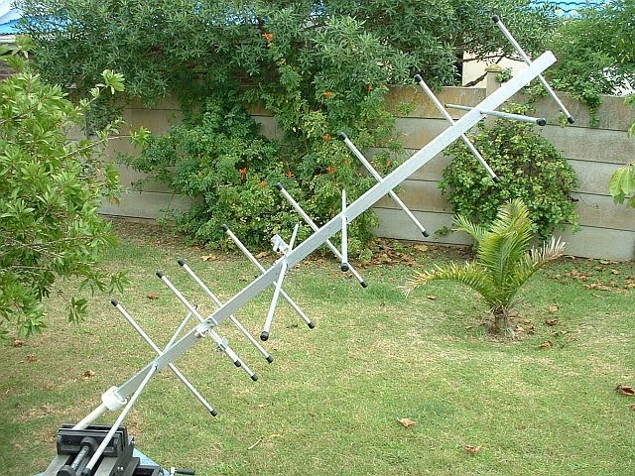
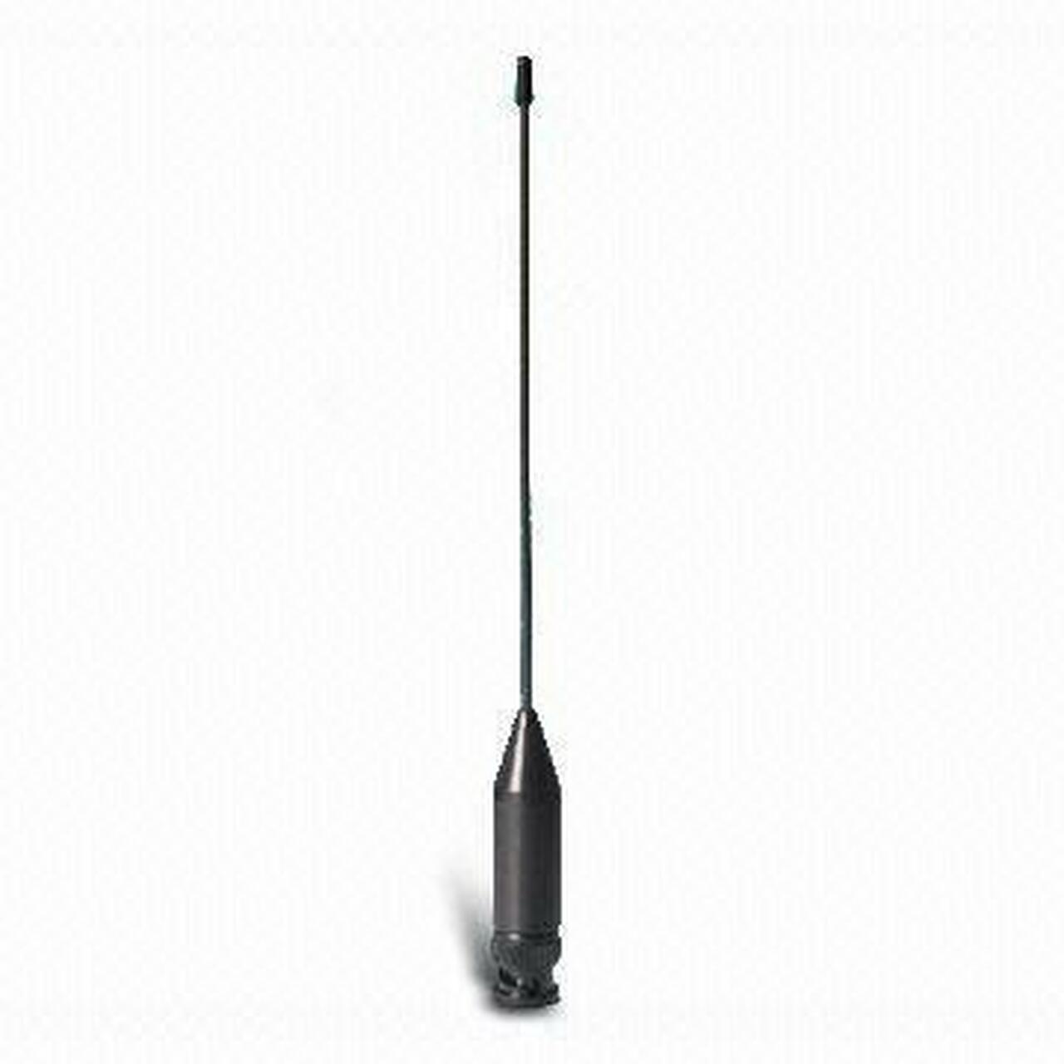
VHF/UHF Antennas
Whip
J-Pole
Vertical
Yagi
High Gain Yagi
0-3dB
3-4dB
4-5dB
10-20dB
>20dB
What differentiates them?
One word : GAIN

Slide 8
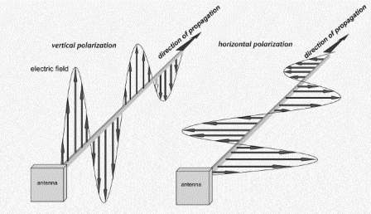
Polarization
Polarization matters
dB losses are huge for off-axis polarization
By convention FM VHF/UHF is vertical polarization.
Digital modes like VARA are FM and vertical
Influence of this is mobile communications
By convention SSB, CW, and some digital modes like FT8 are horizontal polarization.
Typically these are Yagi antennas at these frequencies.

Slide 9
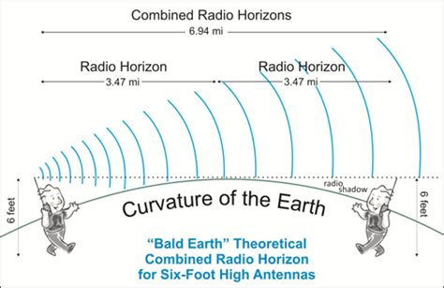
Radio Horizon
https://www.repeater-builder.com/antenna/radio-horizon.html

Slide 10
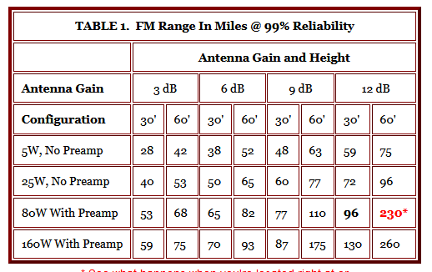
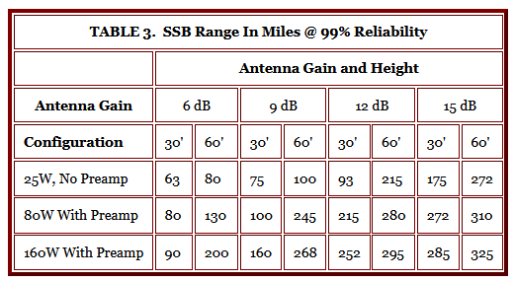
Power, Mode, Height all matter
FM Mode
SSB Mode

Slide 11
What about VHF or UHF Propagation?
At frequencies above 50 MHz there is very little Ionospheric reflection. Signals travel right through the Ionosphere and into outer space.
Tropospheric conditions can “duct” signals beyond the radio horizon. EsNA (Sporadic E) conditions are reported on many space weather sites.
MUF ( Maximum Usable Frequency) tells us what is practical.

Slide 12
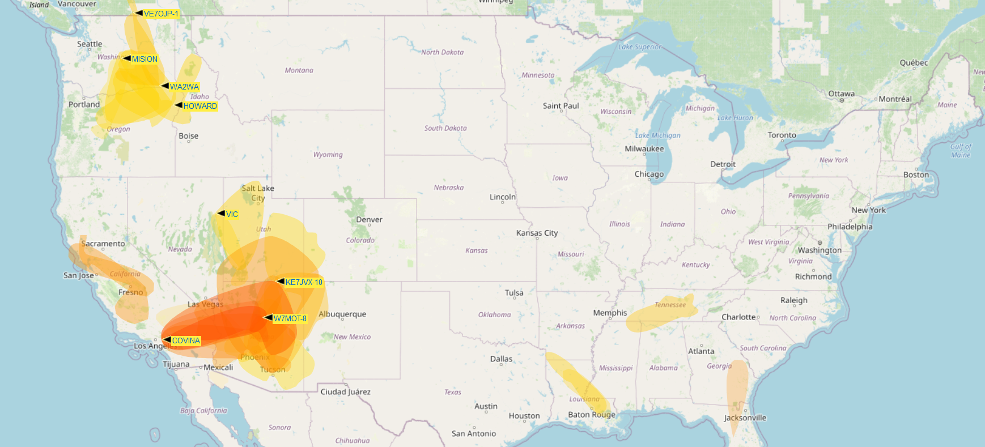
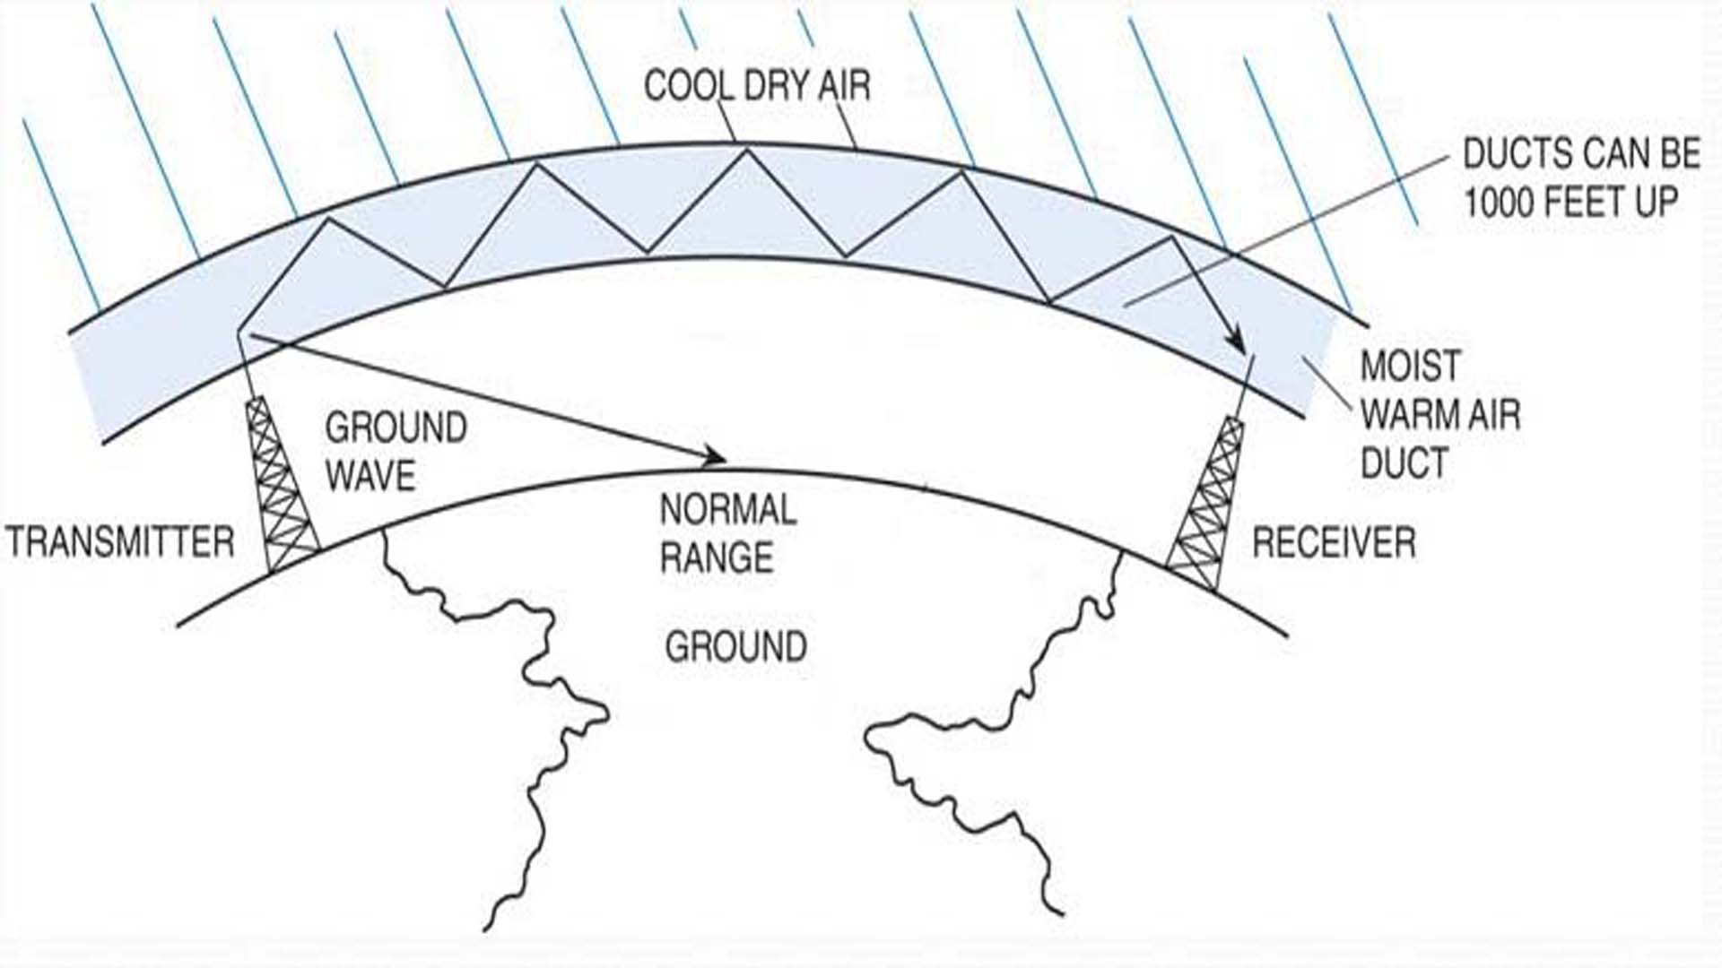
VHF Propagation Map
Predictions for Tropospheric ducting propagation
Other Sources
Dxmaps.com
Dxinfocentre.com/tropo
Aprs.mennolink.org

Slide 13
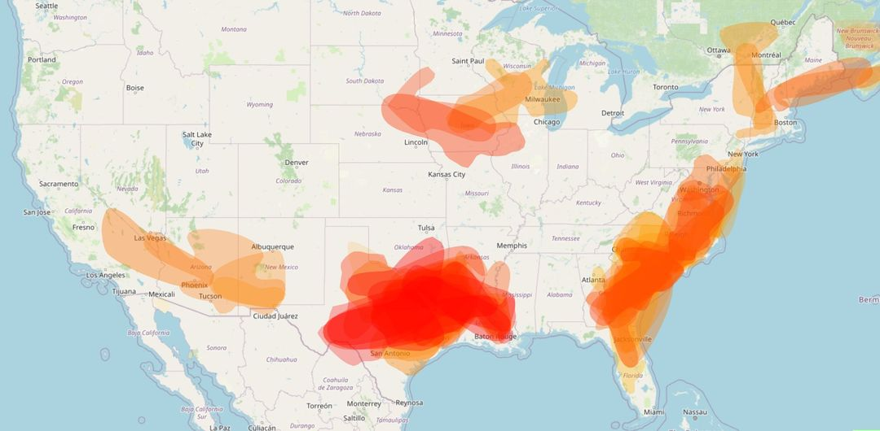
Local example from K4SJR - Frank

Slide 14
How do Repeaters Work?

Slide 15
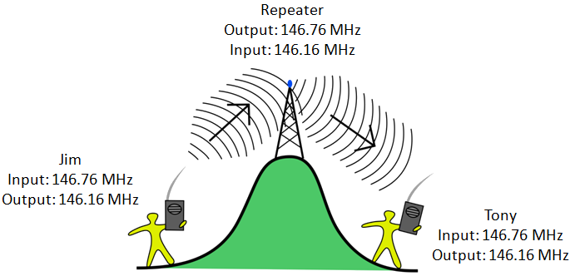
Basic Repeater
145.270 MHz T
144.670 MHz R
CTCSS = 100Hz
CTCSS = Continuous Tone-Code Squelch System
Sometimes called a PL tone (Motorola Private Line)
50 possible sub-audible tones used for squelch control
Can be required for sending and receiving (encode or decode)
145.270 MHz R
144.670 MHz T
KG4VUB
145.270 MHz R
144.670 MHz T

Slide 16
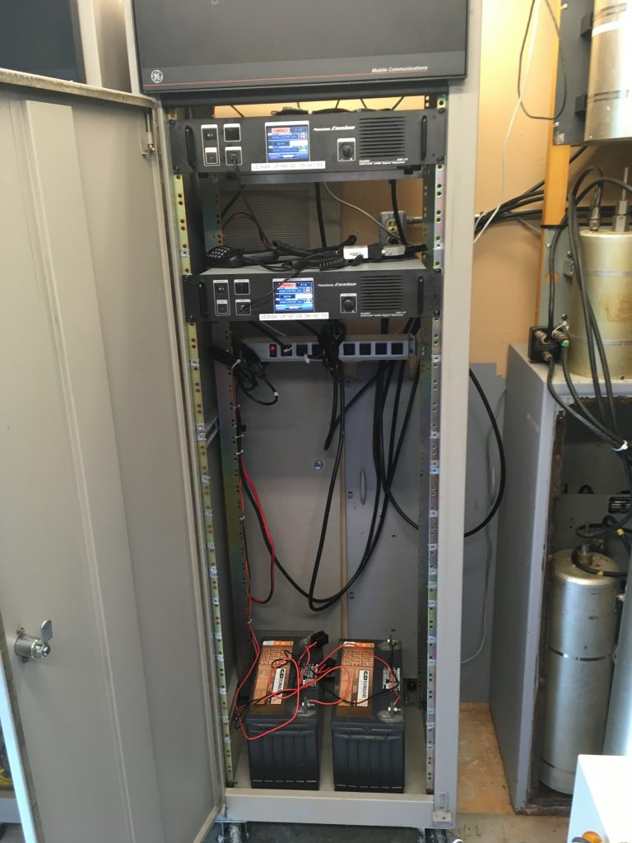
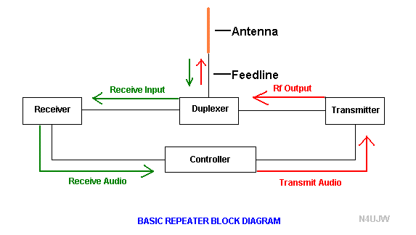
Components of the Repeater

Slide 17
Duplexer makes it all work
Basically a deep notch filter for protecting the receiver from the transmitter’s output frequency
Separate Transmit and Receive antenna do not solve the problem. The receiver would be desensitized in the close proximity of the transmitted signal.
Receive filter notches out the transmitter frequency
Transmitter filter notches out the receiver frequency
Rx Freq
Tx Freq
Tx cavity filter
Rx cavity filter
Ideally at about -100dBm of attenuation

Slide 18
CARS Club
How we apply this information in practice?
What uses does the club have for VHF/UHF?
What is ARES and RACES?
Mark Schulze –KO4IFY will explain how we use VHF and UHF for club activity
ARES and RACES uses for VHF and UHF

Slide 19
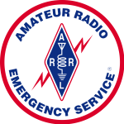
ARES/RACES

Slide 20
ARES/RACES
A
General
Overview

Slide 21
ARES/RACES
Acronyms, acronyms, acronyms
R adio
A mateur
C ivil
E mergency
S ervice
A mateur
R adio
E mergency
S ervices

Slide 22
ARES/RACES
What is ARES?
What is RACES?
What is the difference?
Who makes up ARES/RACES?
What ARES/RACES does?
What ARES/RACES DO NOT do?
What training is required, where is it obtained and how much does it cost?
What equipment is needed and what’s the cost?
How to register?

Slide 23
ARES/RACES
What is ARES?
(ARES) is a volunteer group organized through the American Radio Relay League (ARRL). You do not need to be a member of the ARRL to be part of ARES. The only requirements are to possess an Amateur Radio licensee and have a desire to serve. ARES members enjoy no special privileges and must comply with all FCC and other government rules when operating. If the President chooses to limit access to the Radio Spectrum under the War Powers Act, or another emergency declaration, ARES members must fully comply with these rules.

Slide 24
ARES/RACES
What is RACES?
If the President chooses to limit access to the Radio Spectrum under the War Powers Act, or another emergency declaration, ARES members must fully comply with these rules.
(RACES) was created to deal with just this situation. Amateur Radio Operators must register with the state or local government in advance of an emergency to be part of RACES. There are many special regulations in part 97 of the FCC rules dealing with this service (§97.407). Other than limited drills, RACES can only operate during an officially declared emergency.

Slide 25
ARES/RACES
What is the difference?
The functions are basically the same. A presidential declaration may cause ARES operations to cease and a declaration COULD be made to activate RACES.
Many amateur operators are registered with both organizations so that they can just “change hats” to meet the requirements of any given situation.

Slide 26
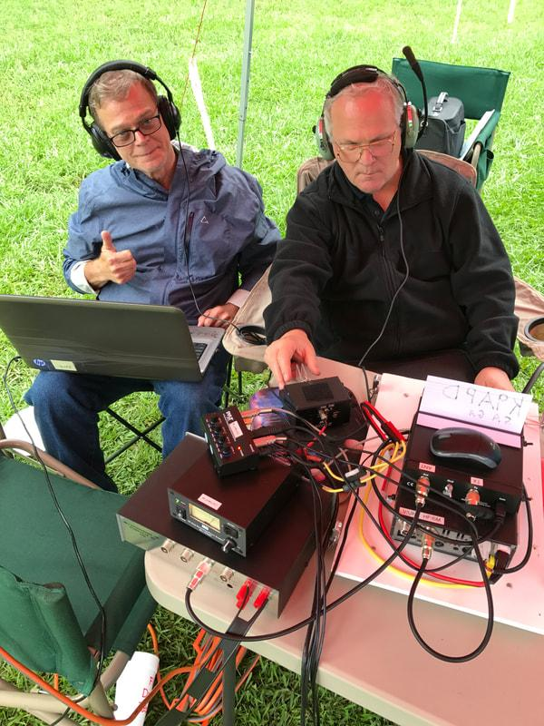
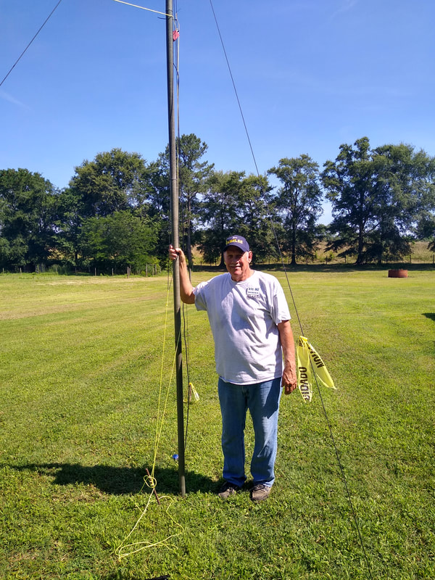
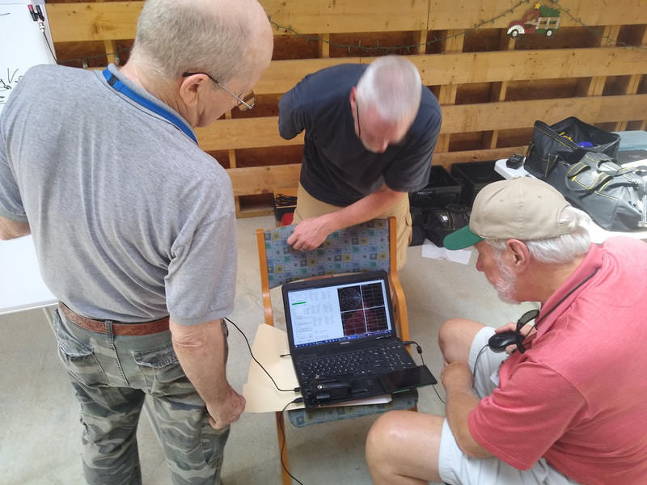
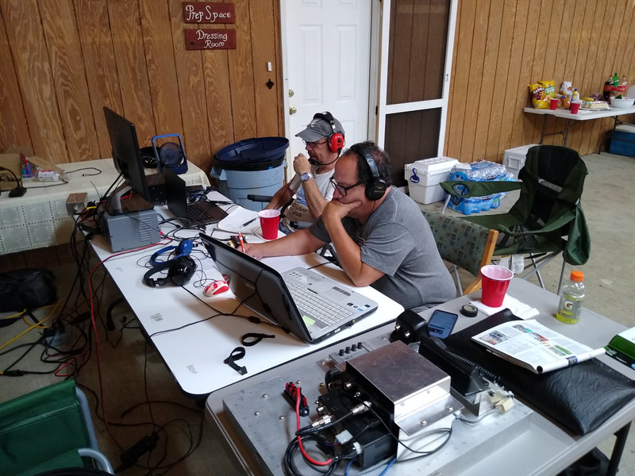
ARES/RACES
Who makes up ARES/RACES?
Fellow Amateur Radio Operators
just like you!

Slide 27
ARES/RACES
What ARES/RACES members do?
ARES/RACES members are a well trained, disciplined group of amateur radio operators that follow the chain of command and endeavor to support the served agency.
ARES/RACES members deploy ONLY when requested by our served agency, and only when approved by the Emergency Coordinator of Cherokee County, or one of the delegated Assistant Emergency Coordinators

Slide 28
ARES/RACES
The Mission
Cherokee County ARES supports our primary served agency, Cherokee County EMA- Emergency Management Agency, and when requested, other agencies in our area or NW GA District.
Cherokee County ARES supports the following activities:
Field Day along with our Club-WX4CAR.ORG
The Georgia Death Race
The Georgia Jewel
NW GA District ARES
The Annual ARRL Simulated Emergency Test (SET)
As needed, Skywarn Weather NETS

Slide 29
ARES/RACES
What ARES/RACES members DO NOT do?
ARES/RACES members are NOT storm-chasers, nor are they First-Responders.
ARES/RACES members DO NOT self-deploy.

Slide 30
ARES/RACES
Training
What training is required?
Where is it obtained?
How much does it cost?

Slide 31
ARES/RACES
What training is required?
The primary training requirements are defined in your personal “ARES Task Book”.
The “ARES Task Book” can be downloaded at no charge from the
Cherokee-ARES.ORG Website

Slide 32
ARES/RACES
Where is the training obtained?
Training consists primarily of on-line self study courses.
ICS Courses are conducted by FEMA.
FEMA Catalog
Additional developmental courses are conducted by the ARRL.
ARRL Catalog

Slide 33
ARES/RACES
How much does the training cost?
NOTHING
NADA
IT IS FREE

Slide 34
ARES/RACES
What equipment is needed and what’s the cost?
You can start with a minimal investment and grow as your knowledge, license privileges and desires (and budget) expands.

Slide 35
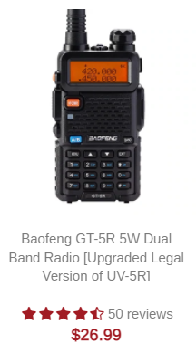
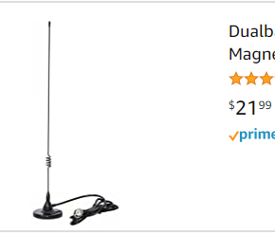
ARES/RACES
An in-expensive HT to start on VHF/UHF.
Add a mag mount antenna.
Approximately $65 can get you
on the air mobile.
Or more and more and more for as much as you want to spend. The hobby with an infinite price cap.

Slide 36
ARES/RACES
What technology gets used by ARES and RACES?
VHF - FM - Base Radios, HT’s, Repeaters
VHF - VARA or Packet FM - Winlink Gateways
Simplex - Within short ranges at events and in the county
HF - for deployments where VHF will not work. (Ex: GA Death Race)
HF - Winlink - Gateways across the country
HF - Nets - SSB, Ex: GA ARES Net on 3.975 MHz
Digital - D-Rats - ratflector

Slide 37
ARES/RACES
How does one register?
Go to: http://www.cherokee-ares.org/registration.html
Complete the Cherokee ARES/RACES Orientation
Download and complete the:
Cherokee ARES/RACES Orientation Quiz
Cherokee ARES FSD-98 Registration Form
Cherokee RACES Registration Form
Send the completed quiz and forms to:
Cherokee.ga.ares@gmail.com

Slide 38
ARES/RACES
Summary
What is ARES?
What is RACES?
What is the difference?
Who makes up ARES/RACES?
What ARES/RACES does?
What ARES/RACES DO NOT do?
What training is required, where is it obtained and how much does it cost?
What equipment is needed and what’s the cost?
How to register?

Slide 39
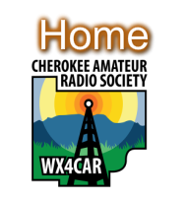
Questions or Comments:

Slide 40
Thank you
Special thanks to all those that unknowingly provided the material for this presentation.

